Slide 1

Grading System
By:
Noa, Kenji Isaac W.
Saragpon, Daniel C.
Vibar, Miles Dominic M.
Zurbano, Ian Christopher L.

Slide 2
Introduction

Slide 3
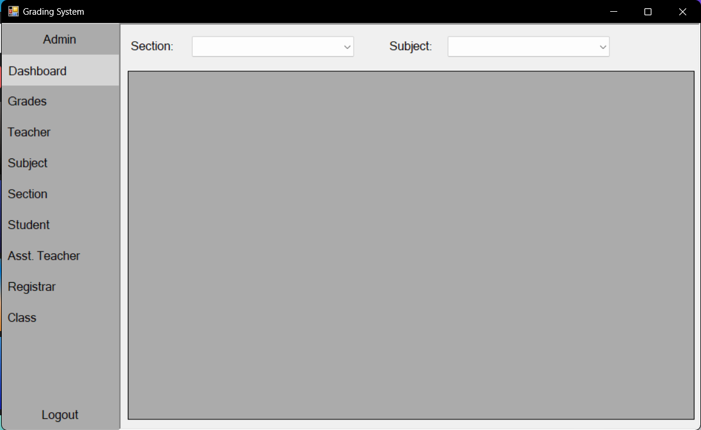
Overview of the Project

Slide 4
Scope

Slide 5
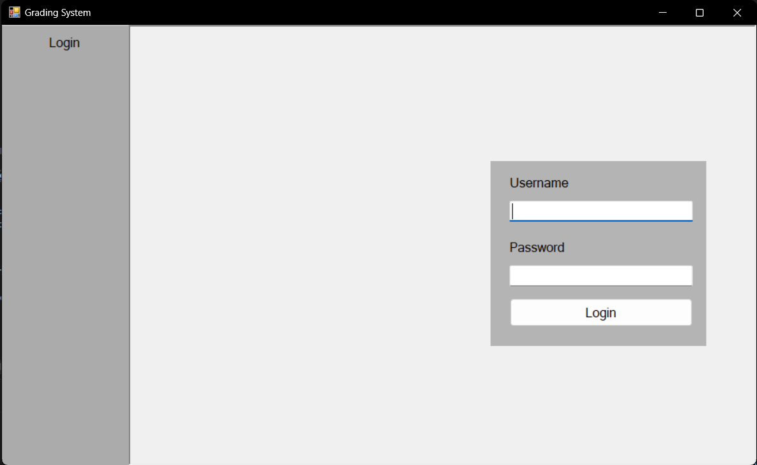
Login Module

Slide 6
Login Module

Slide 7
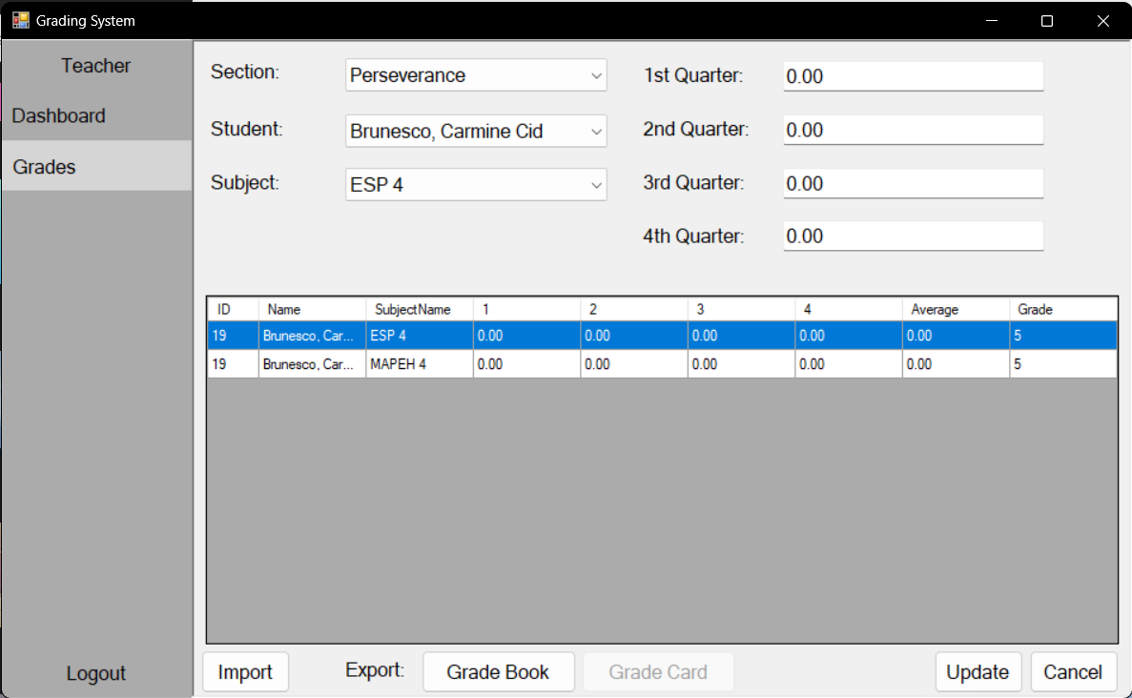
Grades Module

Slide 8
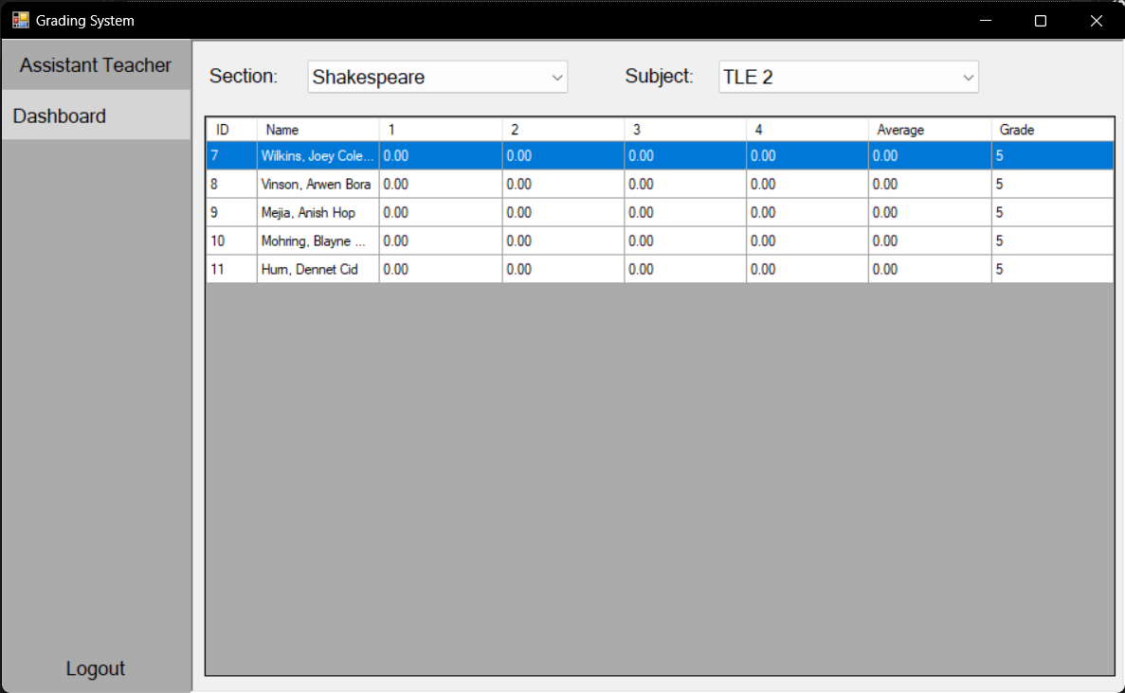
Assistant Teacher Module

Slide 9
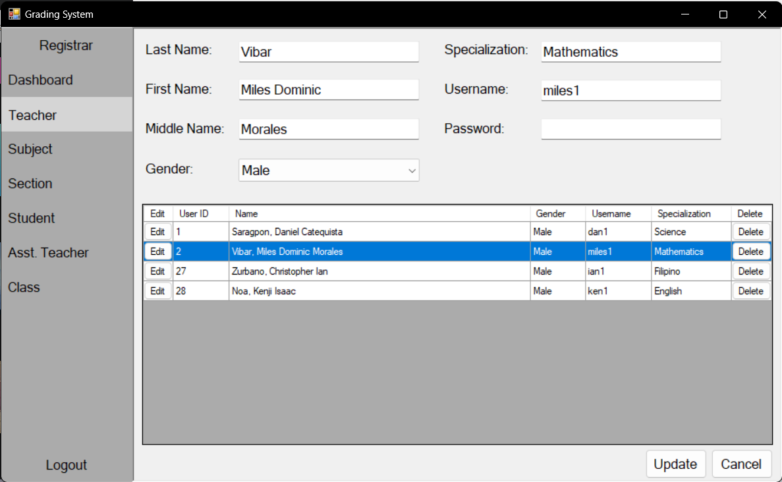
Registrar Module

Slide 10
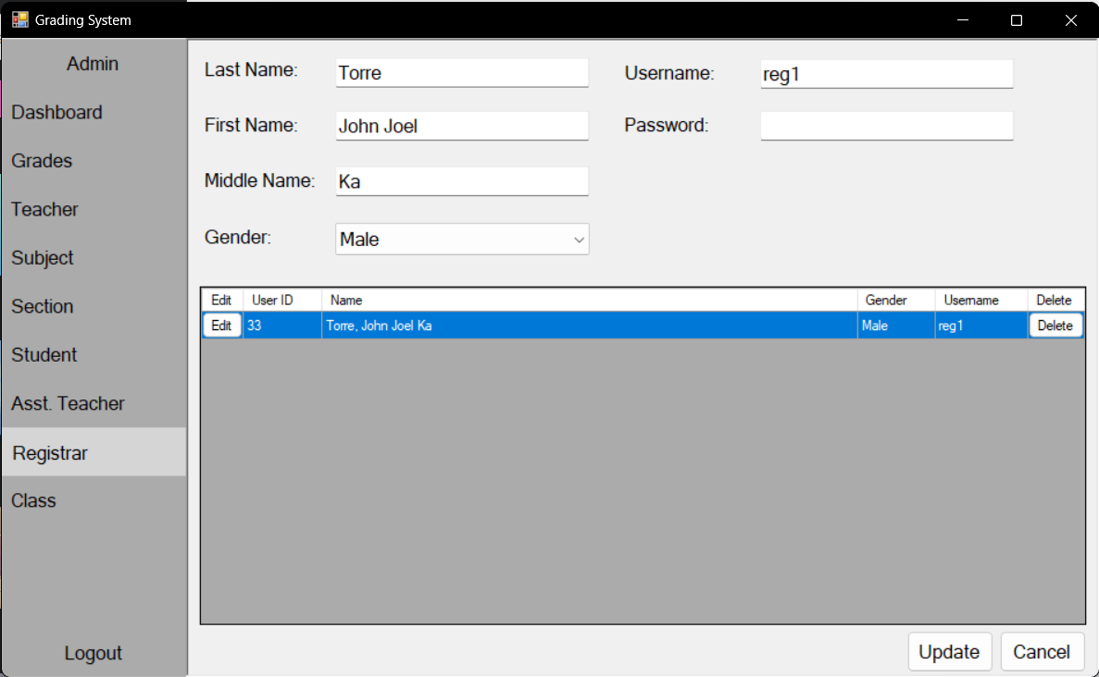
Admin Module

Slide 11
Roles
Super Admin
User Level 2
User Level 1
Registrar
&
Teacher
Assistant Teacher
Admin

Slide 12
Diagrams

Slide 13
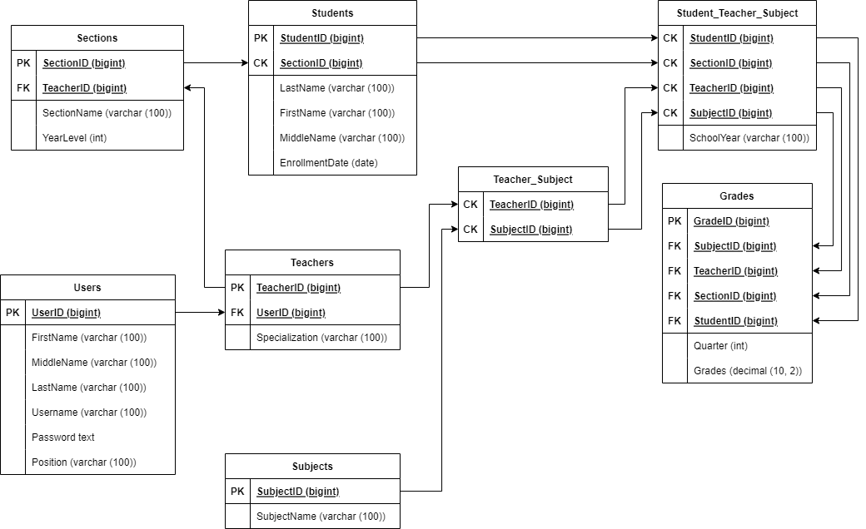
Star Schema

Slide 14
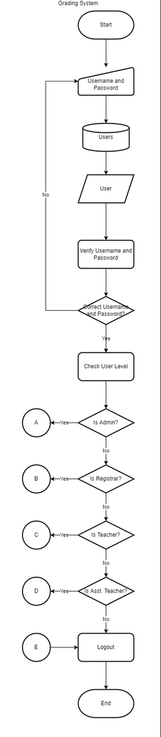
Flowchart

Slide 15
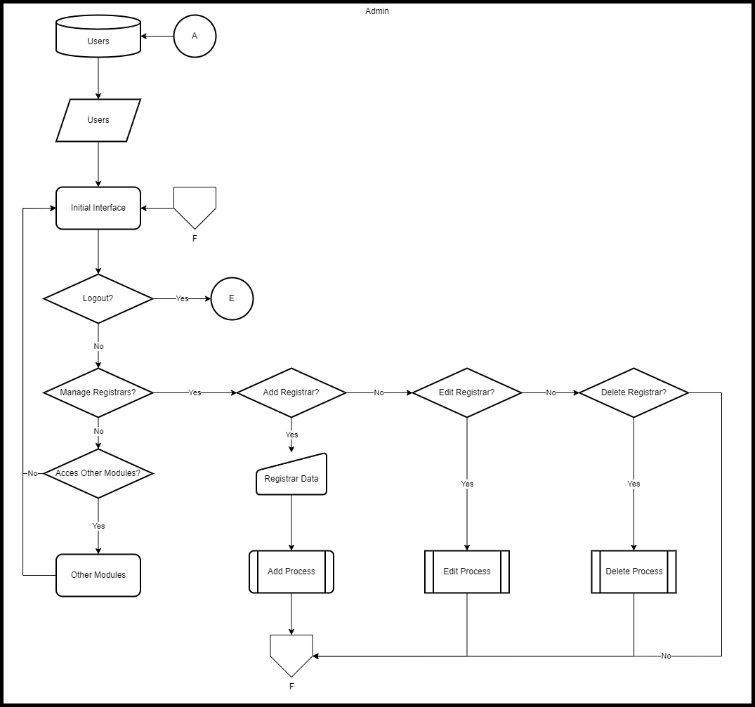
Admin Flowchart

Slide 16
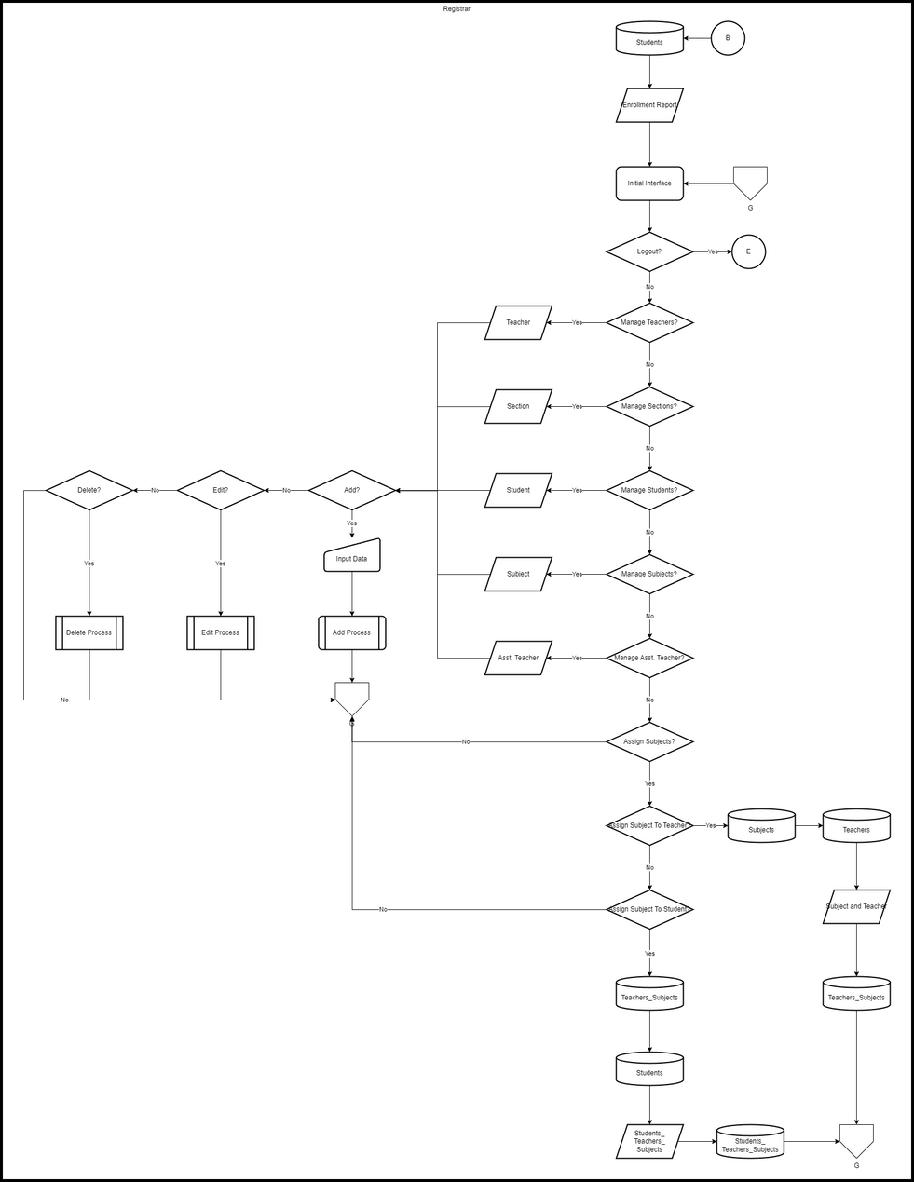
Registrar Flowchart

Slide 17
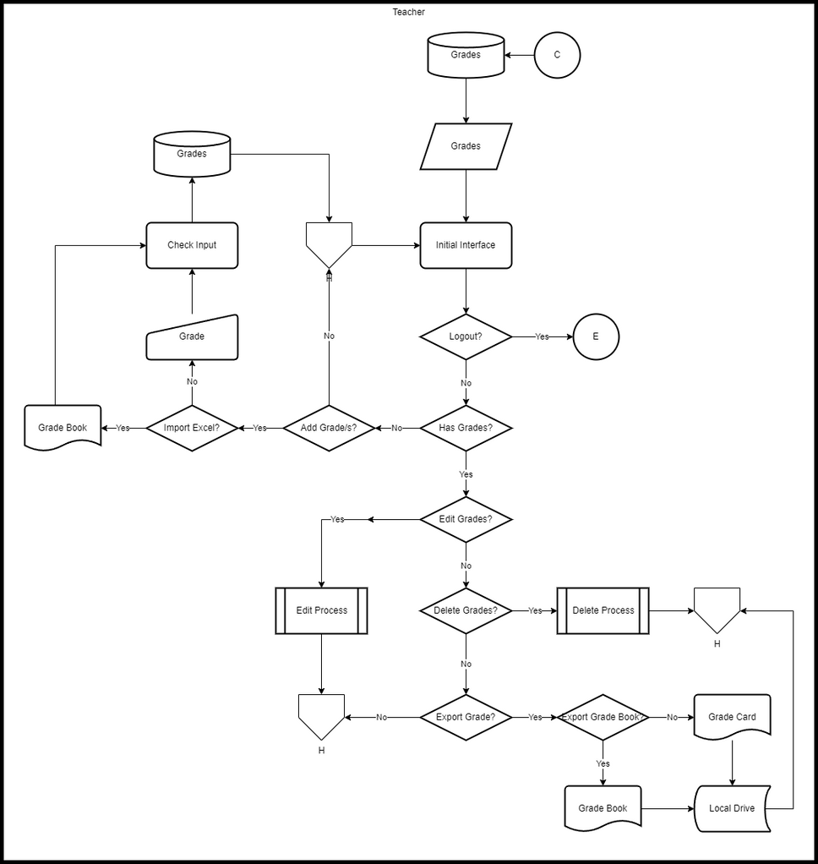
Teacher Flowchart

Slide 18
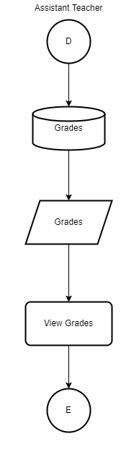
Assistant Teacher Flowchart

Slide 19
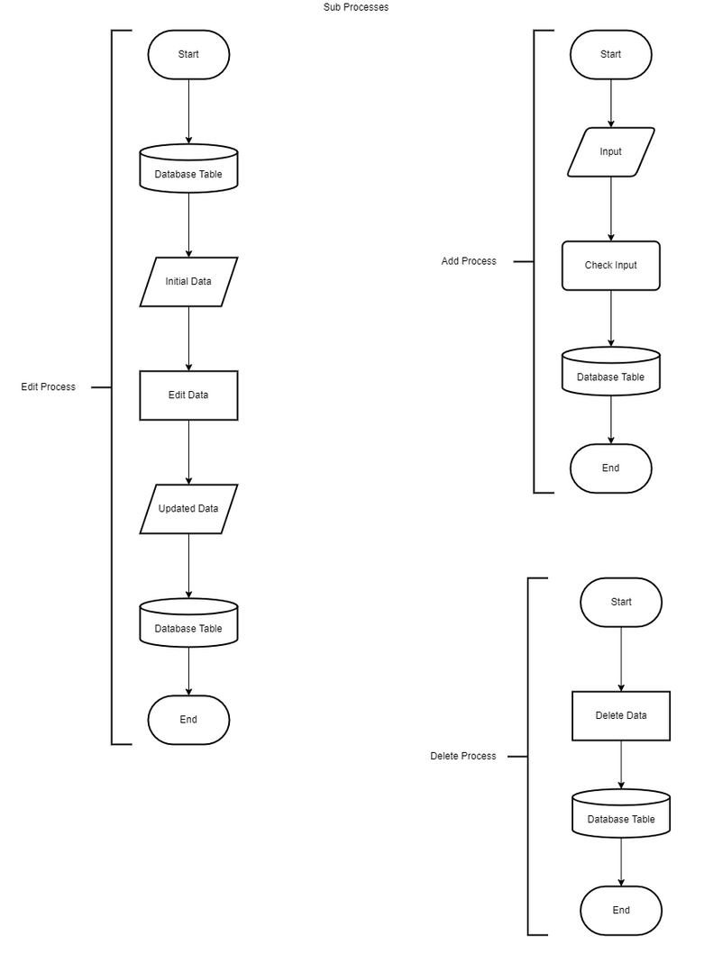
Sub-processes

Slide 20
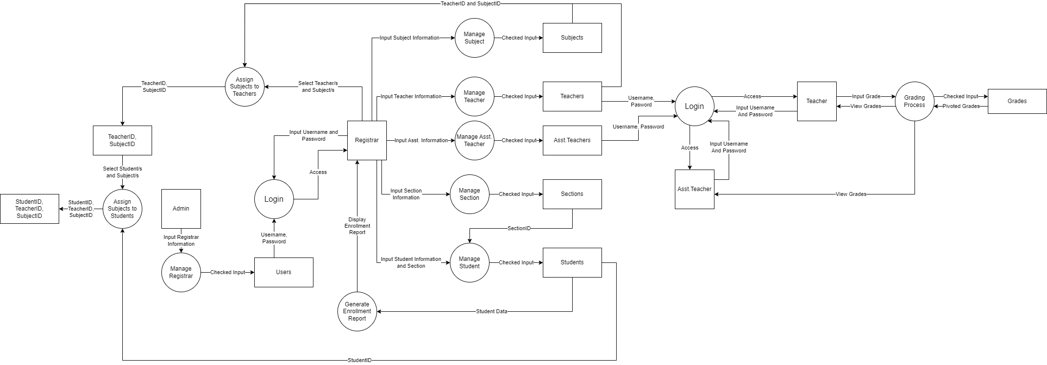
Data Flow Diagram

Slide 21
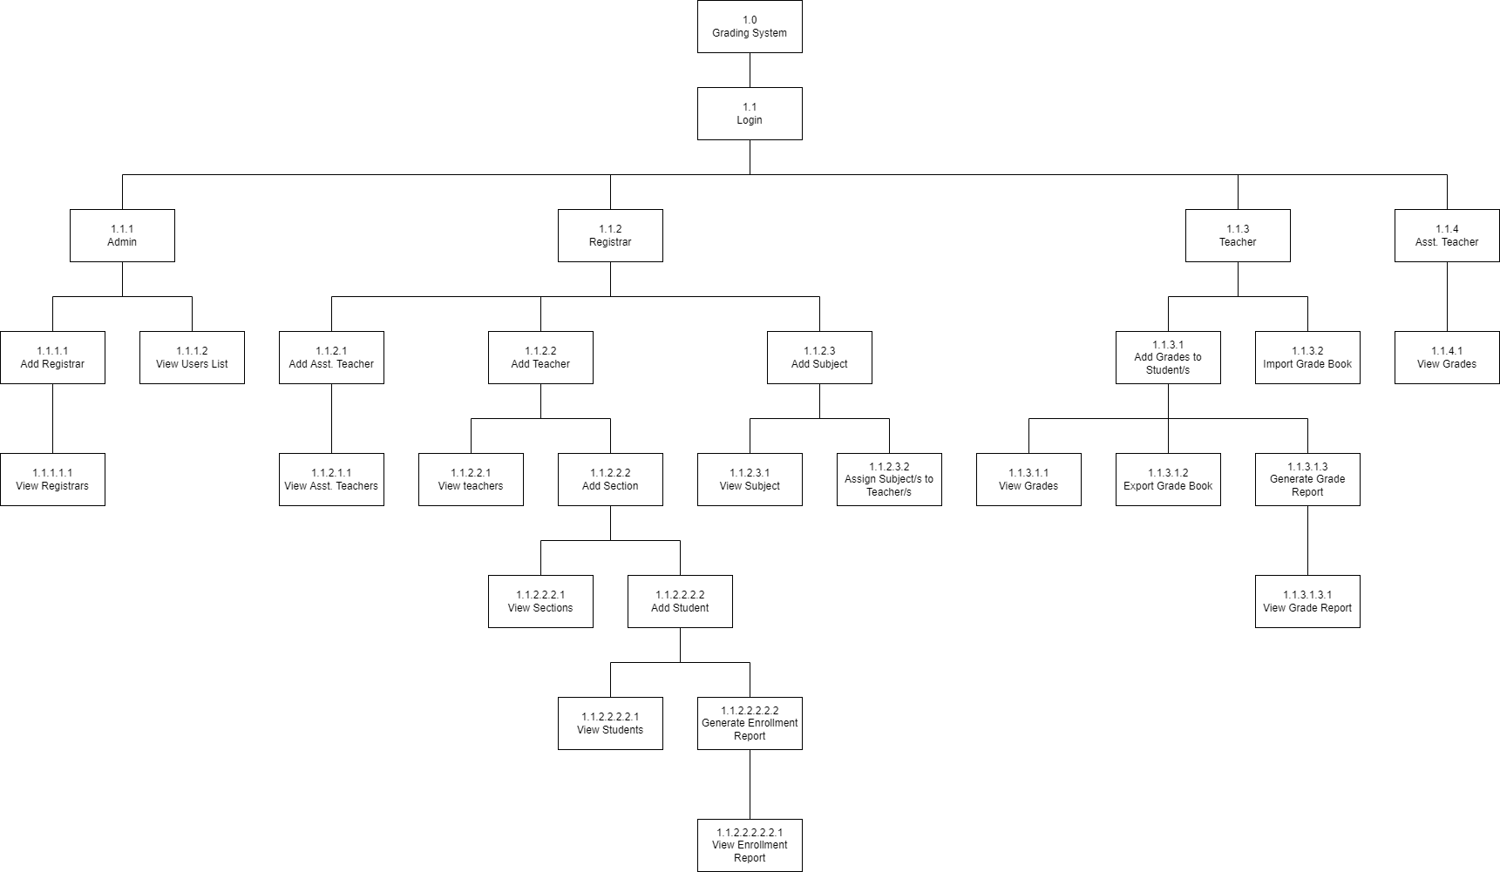
HIPO Diagram

Slide 22
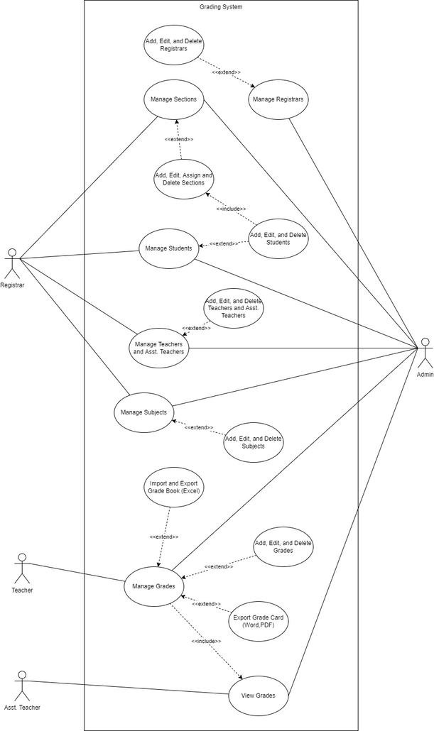
Use Case Diagram

Slide 23
Grading System
By:
Noa, Kenji Isaac W.
Saragpon, Daniel C.
Vibar, Miles Dominic M.
Zurbano, Ian Christopher L.

